Slide 1

Markov Chain Modeling for Anomaly Detection in HPC System Logs
Abida Haque (NCSU),
Alexandra DeLucia (Rollins College), Elisabeth Baseman (LANL)
Workshop on HPC User Support Tools
SC’17
11/12/17
LA-UR-17-26667

Slide 2
Motivation
Making a transition matrix
Real Syslogs
Creating the matrix
Seeing ‘normal’ behavior
Using model to discover anomalies
Results
Future Work

Slide 3


Motivation
Too much syslog data for sysadmins
How can we model the data?
Markov chain model
Evaluate anomaly detection using precision and recall
=
A tool which can assist sysadmins!

Slide 4
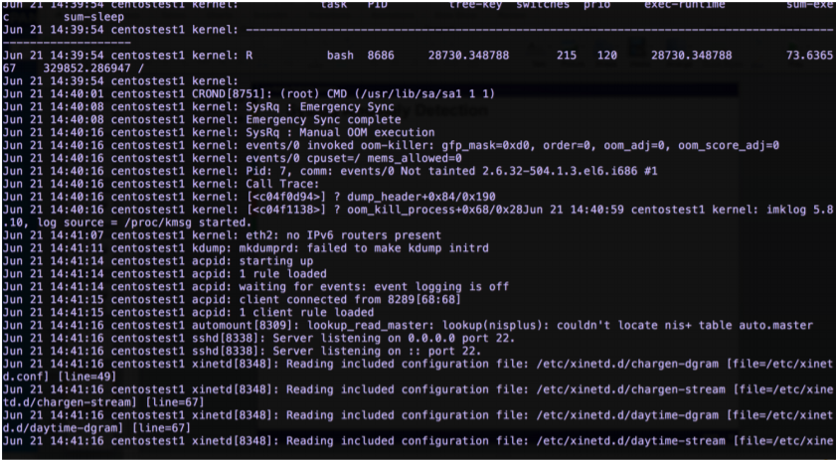
Real Syslogs

Slide 5
Making a Transition Matrix

Slide 6
Processing Real Syslogs
Clean up and label messages with a number
Example:
Enumeration | Message
0 | Starting up
1 | Client connected from [:]
2 | The audit daemon is exiting
1 | Client connected from [:]

Slide 7


Creating the matrix
Sequence of enumerated messages, eg:
X = [1,2,3,1,3,3,4]
Count up each transition in the syslog:
1 → 2
2 → 3
Etc…
Simplify the data and organize it!

Slide 8

Markov Transition Matrix
Count up the number of transitions
Count up the number of times a message appears overall
Divide to get a probability
Save in a matrix

Slide 9

Algorithm
Create transition matrix using training syslog
On a test sequence, determine the probabilities of transitions
Return the least probable transitions
Those are the lines most likely to be anomalous!

Slide 10
Results

Slide 11
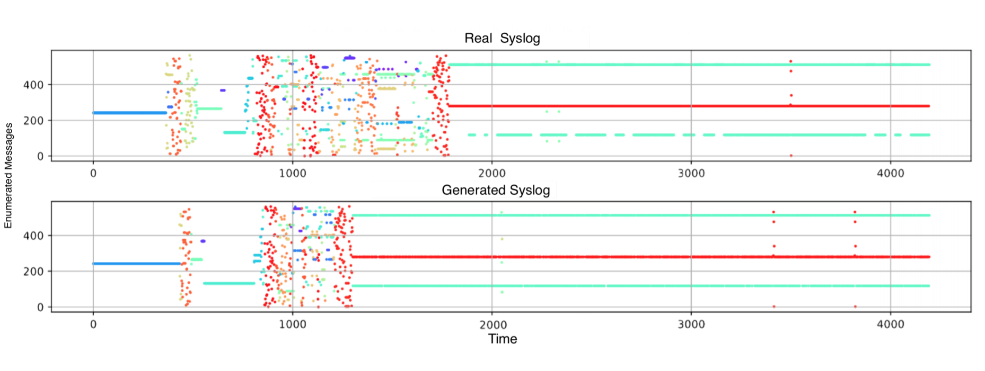
‘Normal’ behavior
Do a random walk based on the transition matrix
Compare visually

Slide 12

How anomalous?
Two scoring schemes
Just use message transition probabilities
Weight the message transition probabilities with tag probabilities
Various daemons, the kernel
This way gives better results!

Slide 13

Evaluating the Model
Deletions
Started with lines 1 2 3 in order
Remove line 2: 1 2 3
Hopefully 1 gets marked as anomalous!
Insertions
1 2 3
1 2 4 3
Both 2 and 4 should get marked!

Slide 14
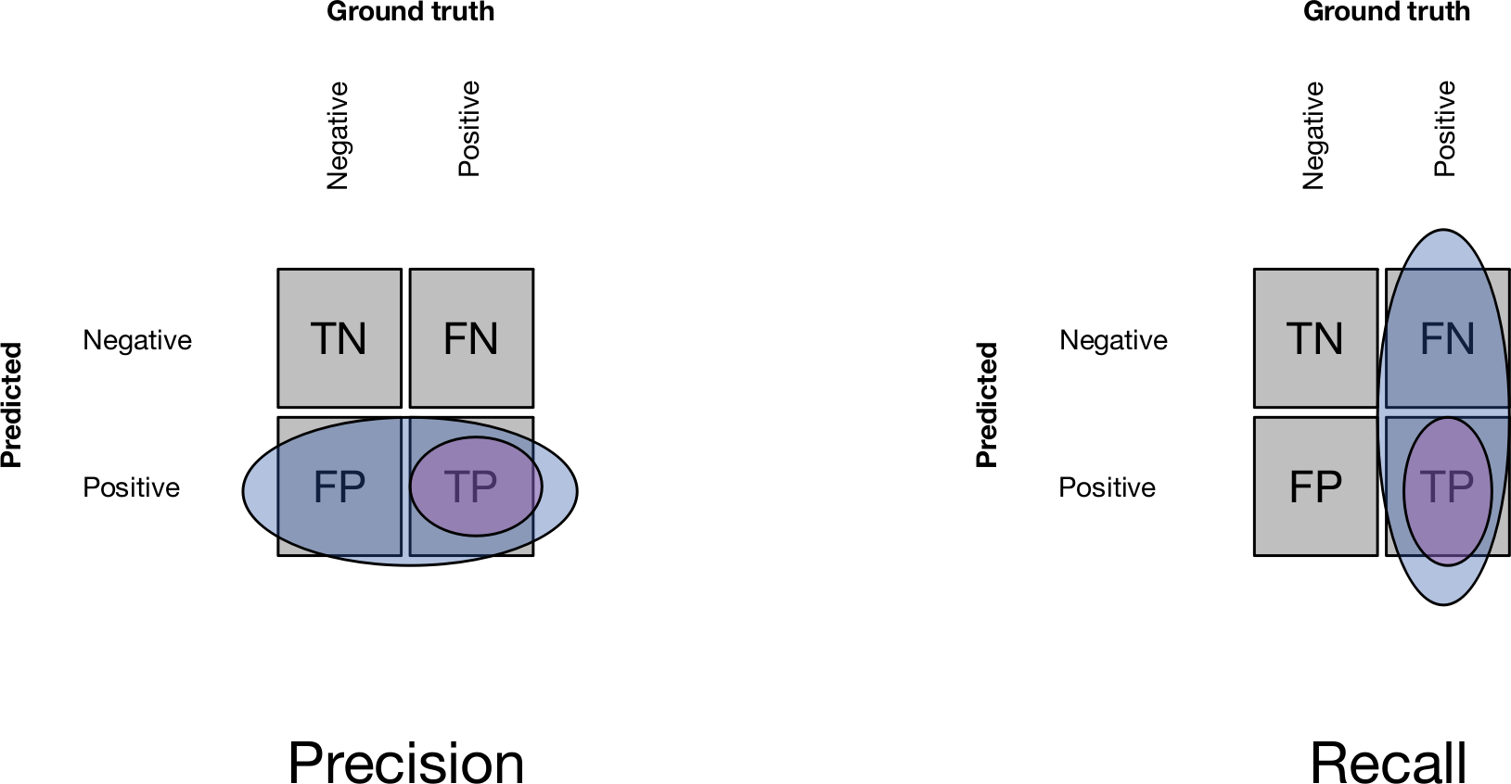
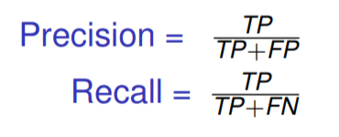
Precision and Recall

Slide 15
Future Work

Slide 16

A tool for admins
Create transition matrix for logs for some training period
Check the transition matrix against logs for testing period
Return top X answers
Sysadmin checks the messages and segments around those lines.
Maybe a new message appears?
If message is normal, add to the model!
Use sysadmin’s domain expertise!

Slide 17

Improvements to the Model
Using printk messages
Topic modeling (finding keywords using TF-IDF) in the messages.
Clustering the messages
Using the topic vector (k-means clustering)
Using the transition matrix (Markov chain clustering).
Data stream
Adding time stamp

Slide 18
Thank you!
With special thanks to everyone
Lissa Baseman
Alexandra Delucia
Sean Blanchard
Los Alamos National Laboratory
New Mexico Consortium
Ultrascale Systems Research Center
Any questions?
For further questions: ahaque3@ncsu.edu

